Slide 1
Multi-Layer Perceptron (MLP)
Dr. Sifat Momen

Slide 2
MLP Notation and trainable parameters
https://medium.com/@aryanrusia8/mlp-notation-and-trainable-parameters-fb2d30235ec1

Slide 3
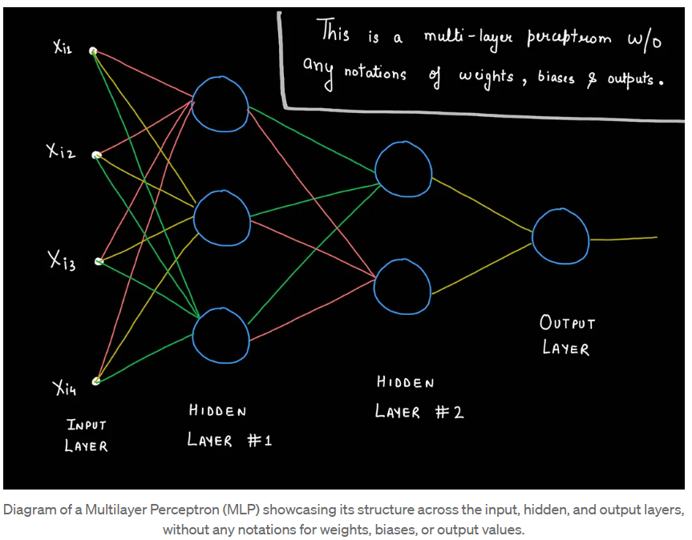

Slide 4
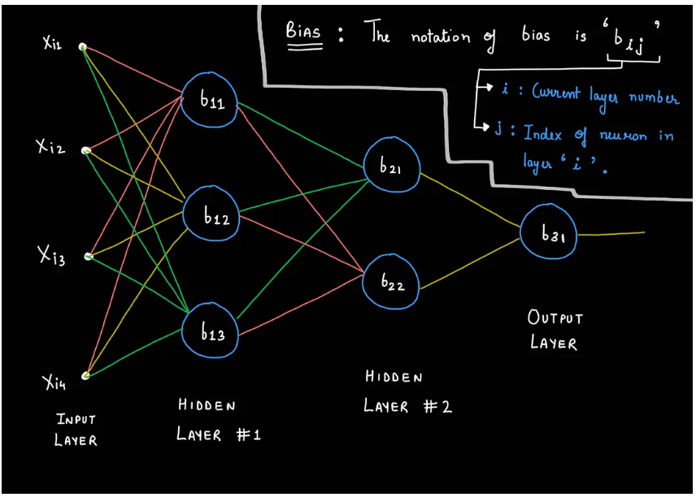
Bias Notation
In MLP notation, the bias associated with a particular neuron is typically represented by b, with subscripts to indicate its position within the network. The standard notation used is bᵢⱼ, where
i represents the layer number (starting from 1 for the first hidden layer since input layers do not have biases).
j indicates the index of the neuron within layer i.

Slide 5
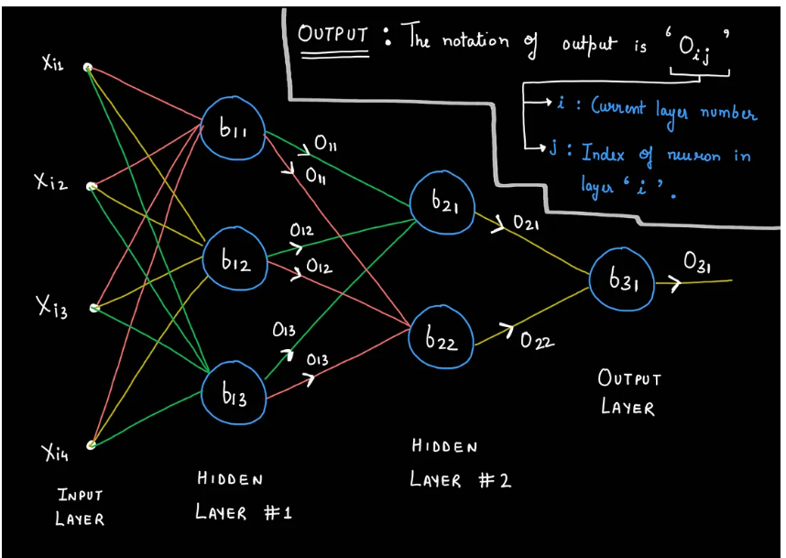
Output Notation
In MLP notation, the output associated with a specific neuron is denoted by O, with subscripts to indicate its position within the network. The standard notation used is Oᵢⱼ, where
i represents the layer number (starting from 1 for the first hidden layer, as input layers do not produce outputs in this context).
j indicates the index of the neuron within layer i.

Slide 6

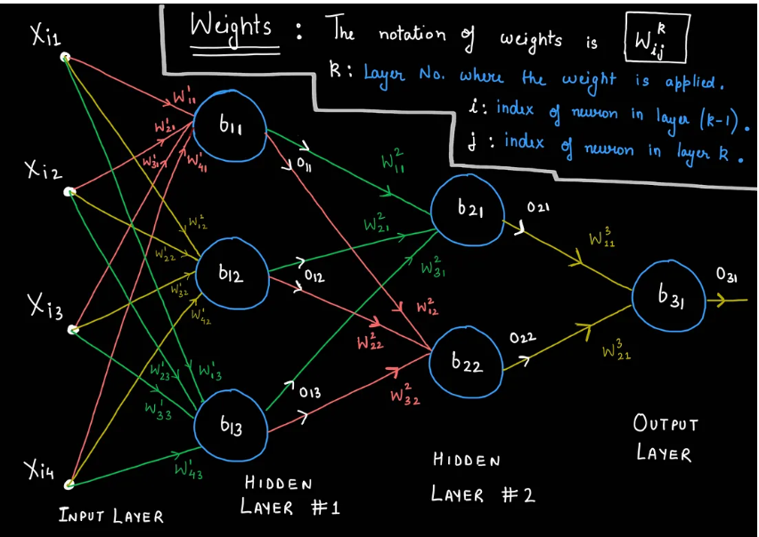
Weight Notation
k: Layer number where the weight is applied, specifically from layer k-1 to layer k.
i: Index of the neuron in the previous layer k-1 where the connection originates.
j: Index of the neuron in the current layer k where the connection is targeted.

Slide 7
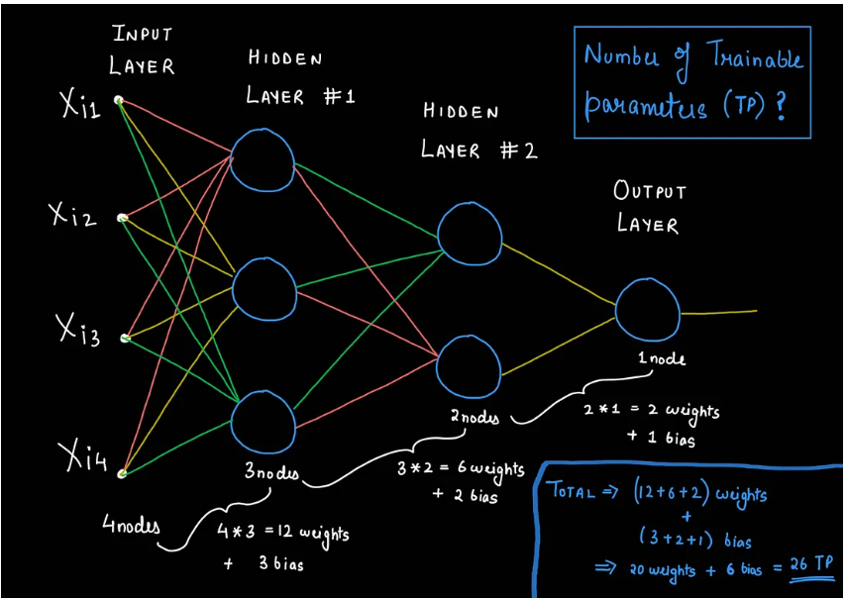
Number of trainable parameters

Slide 8
MLP Intuition
https://medium.com/@aryanrusia8/multi-layer-perceptrons-explained-7cb9a6e318c3

Slide 9
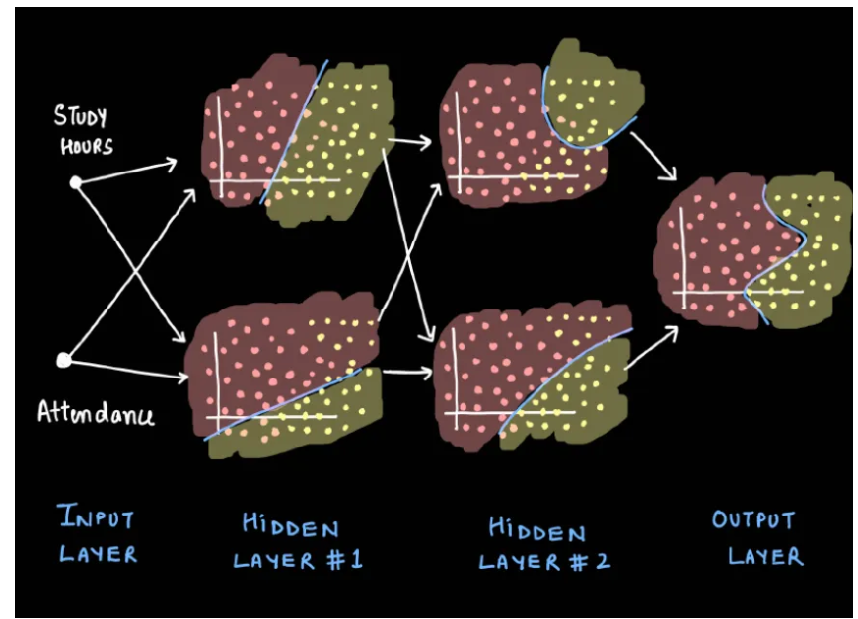
MLP

Slide 10

Issue with Perceptron

Slide 11
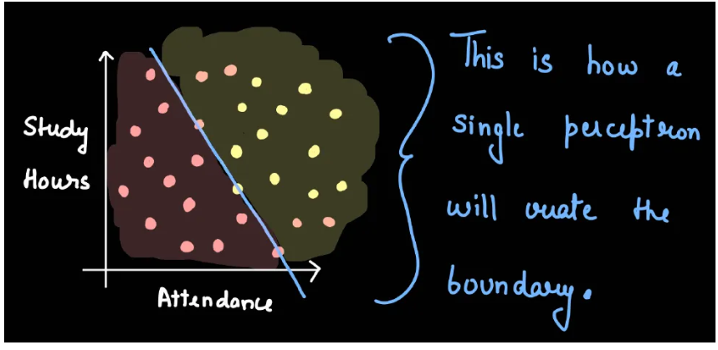
Issue with Perceptron

Slide 12
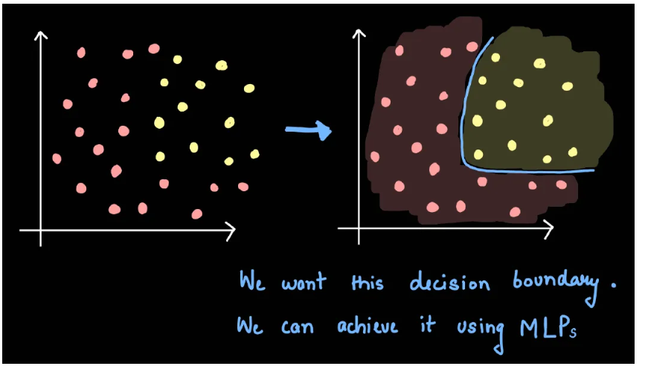
Issue with Perceptron

Slide 13
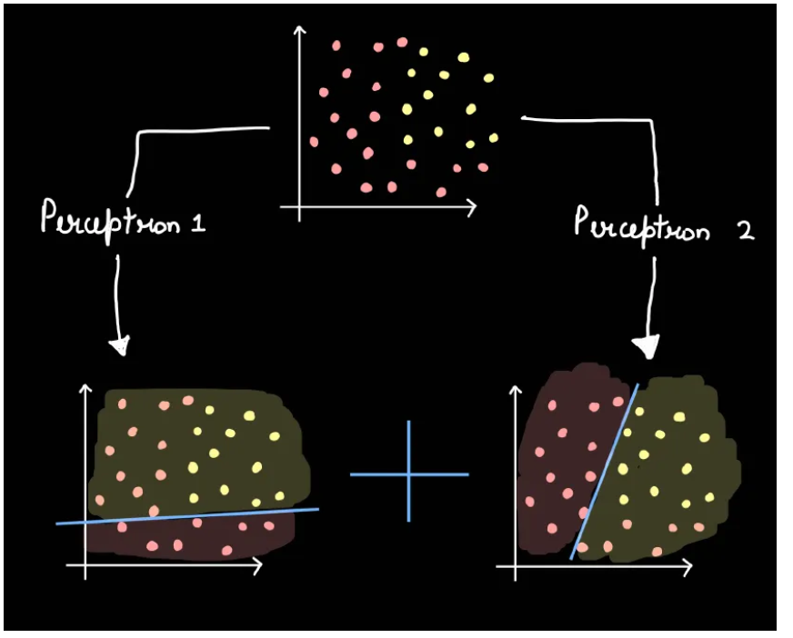
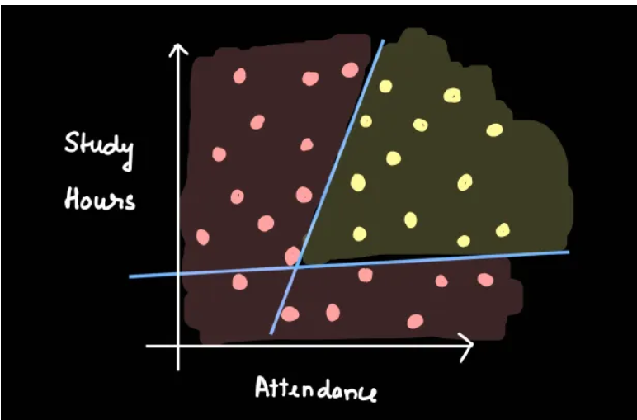
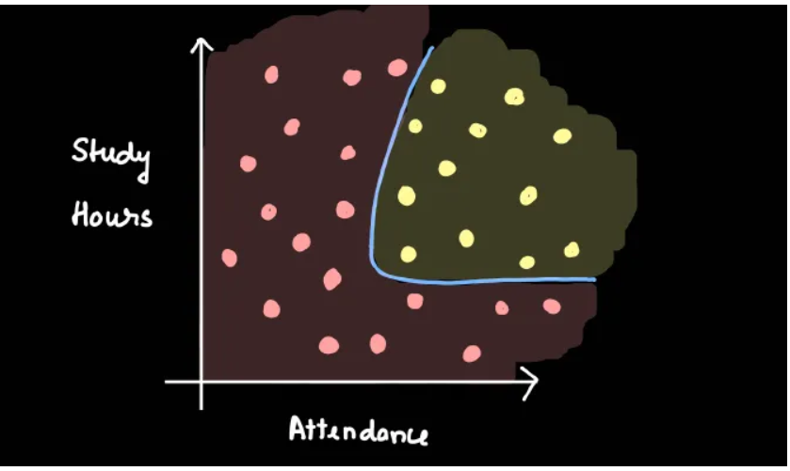
Intuition behind multiple Perceptrons

Slide 14
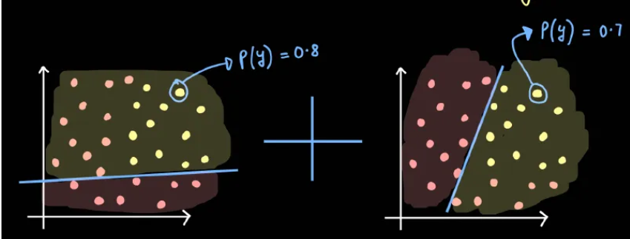
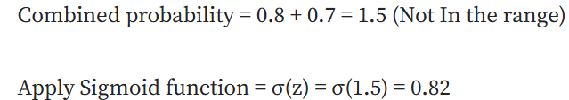
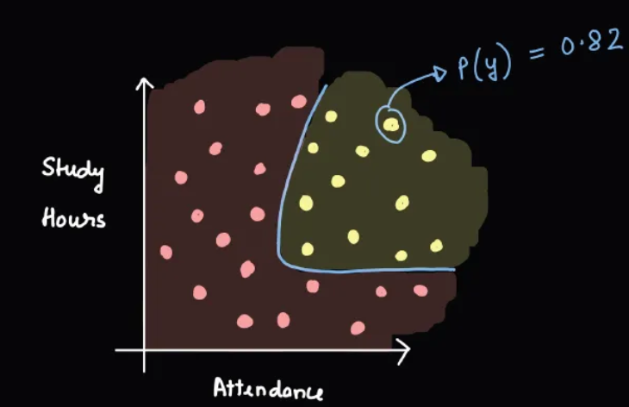
Mathematics Behind it

Slide 15
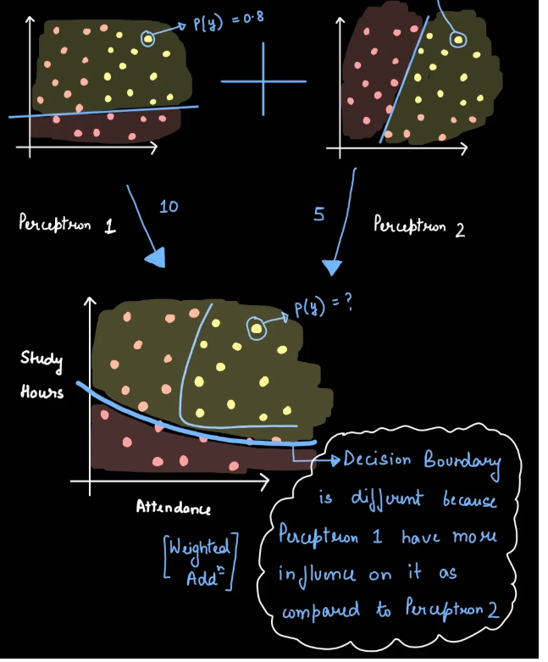
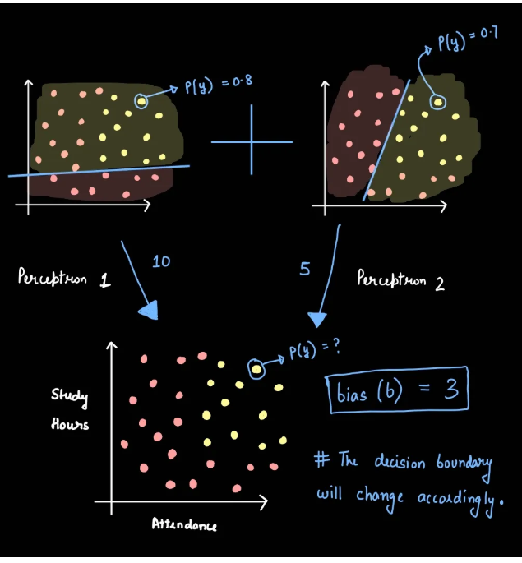
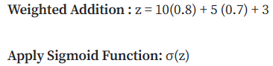

Slide 16
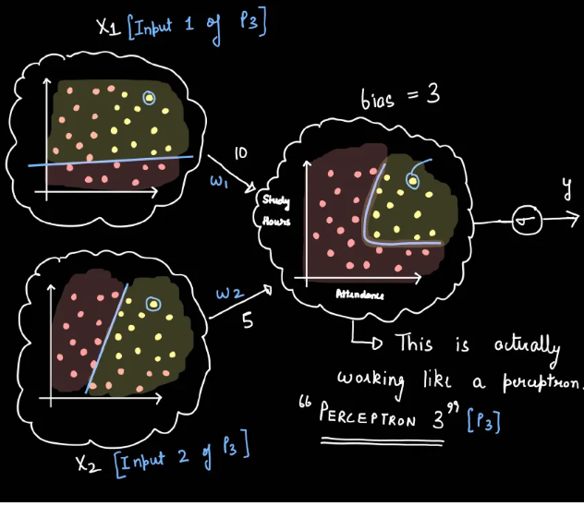
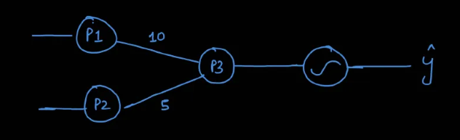

Slide 17
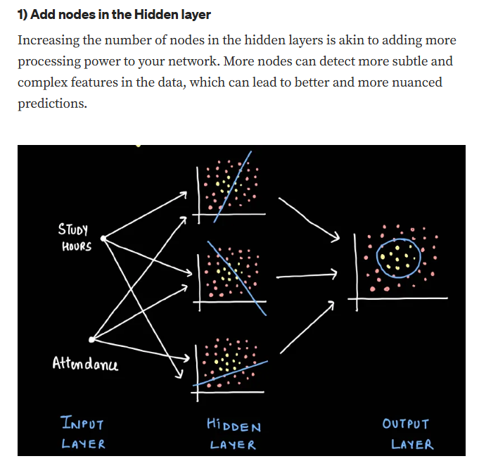
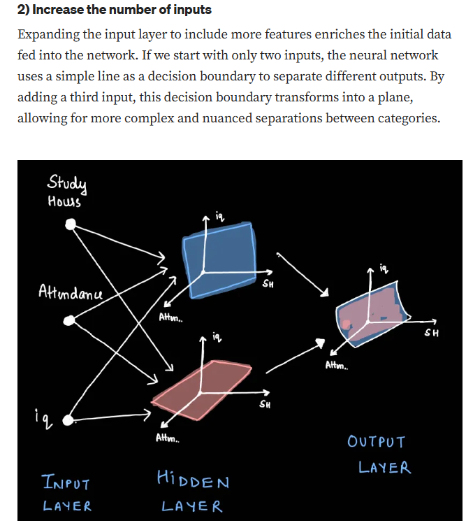
How can we change the architecture?

Slide 18
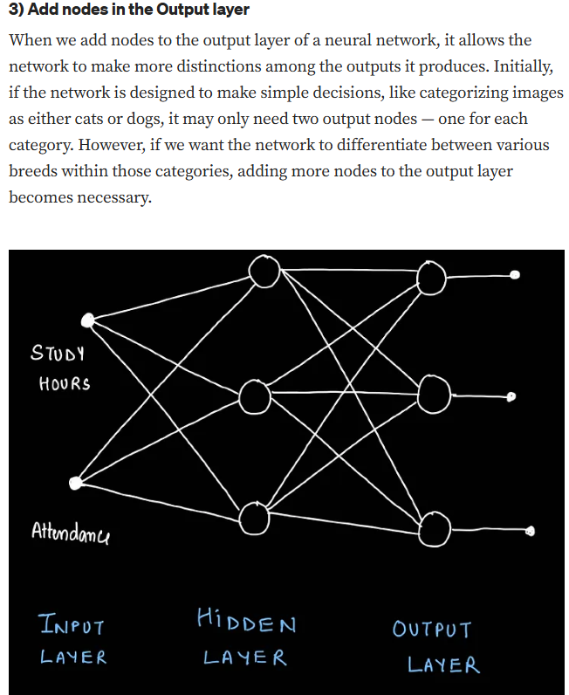
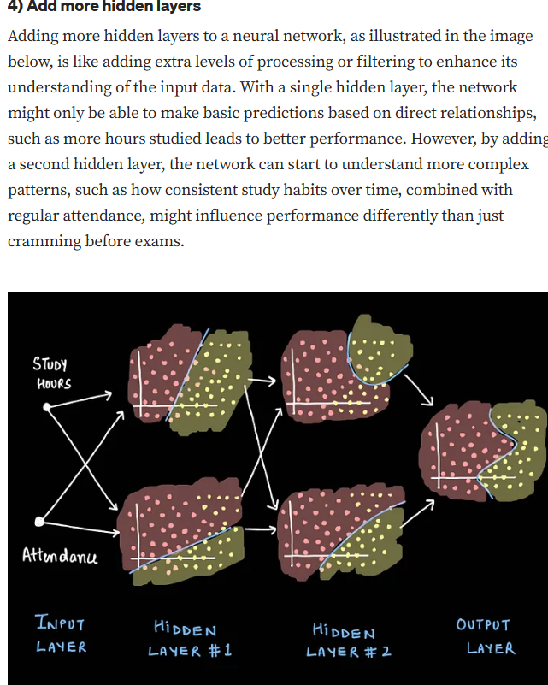
How can we change the architecture?

